Slide 1
Economics
Week #2

Slide 2
Topics of Week #2
Shift in Production Possibilities Curve*
Comparative Advantage
Absolute Advantage
Terms of trade
Investment/Capital Goods and Future Growth*
"*" Indicates the most important topics.
Mateer and Coppock: Chapter #2

Slide 3
Shift in the PPF
If the PPF were to expand outward, some previously unattainable good combinations would now be possible to produce.
The PPF could shift graphically in two ways.
New resources or technology could be introduced that either
Affect the production of one good, or
Affect the production of both goods.

Slide 4
Shift in the PPF
Notes:
Here, a new technology allows us to produce more pizzas, but our wing production capabilities are not changed.
With the new technology, it becomes possible to produce 120 pizzas in the same amount of time that it previously took to produce 100 pizzas. However, the ability to produce wings has not changed—it remains the same as before. The result is that the production possibilities frontier expands outward from PPF₁ to PPF₂. If society had been operating at point A, the new pizza technology makes it possible for society to move to point B. Even though society is not any better at producing wings, the movement from A to B illustrates that society can now choose a new point along PPF₂ where it is capable of producing more of both (80 pizzas and 220 wings). Improvements in technology make point B possible. Since the production of pizzas has become more efficient, society needs fewer resources to produce pizzas. This frees up resources to make more pizzas and also more wings.

Slide 5
Shift in the PPF
Notes:
Here, more resources allow to produce more of all goods. Additional resources could include more people, land, or natural resources.
Because the additional resources make the production of more pizzas and wings possible at the same time, the curve moves from PPF₁ to PPF_{2,} expanding up along the y axis and out along the x axis. Like improvements in technology, additional resources expand the frontier and allow society to reach a point—in this case, C—that was not possible before.

Slide 6
Practice What You Know Production Possibilities Frontier
You will have 30 seconds each to answer a number of true/false questions.
Please join up with a partner.

Slide 7
Practice What You Know Production Possibilities Frontier
(True/False) Point A represents the amounts of cars and bicycles that will be sold.
Bicycles
A
Cars

Slide 8
Practice What You Know Production Possibilities Frontier
(True/False) Point A represents the amounts of cars and bicycles that will be sold.
False.
It represents how many cars and bicycles are produced!
Bicycles
A
Cars

Slide 9
Practice What You Know Production Possibilities Frontier
(True/False) As you move from point F to point G, the price of bicycles increases.
Bicycles
G
F
Cars

Slide 10
Practice What You Know Production Possibilities Frontier
(True/False) As you move from point F to point G, the price of bicycles increases.
False.
The number of bicycles produced increases.
Bicycles
G
F
Cars

Slide 11
Practice What You Know Production Possibilities Frontier
(True/False) Movement along the curve from point C to point A shows us the opportunity cost of producing more bicycles.
Bicycles
C
A
Cars

Slide 12
Practice What You Know Production Possibilities Frontier
(True/False) Movement along the curve from point C to point A shows us the opportunity cost of producing more bicycles.
Bicycles
False.
It represents the opportunity cost of producing more cars.
C
-
A
+
Cars
Notes:
We produced more cars. How many bicycles did we have to give up to do this?

Slide 13
Practice What You Know Production Possibilities Frontier
(True/False) If we have high unemployment, then the curve shifts in.
Bicycles
?
Cars

Slide 14
Practice What You Know Production Possibilities Frontier
(True/False) If we have high unemployment, then the curve shifts in.
False.
Unemployment means that not everyone is working so production is inside the PPC. The PPC stays put since it represents the maximum output if all resources are being used to the fullest.
Bicycles
?
Cars
Notes:
The curve itself represents what we CAN produce.
If we are at high levels of unemployment, then we are producing at a point inside the curve. However, the amount that we actually COULD produce doesn't change!

Slide 15
Practice What You Know Production Possibilities Frontier
(True/False) If an improved process for manufacturing cars is introduced, then the entire curve will shift out.
Bicycles
?
Cars

Slide 16
Practice What You Know Production Possibilities Frontier
(True/False) If an improved process for manufacturing cars is introduced, then the entire curve will shift out.
False.
The curve only moves out along the car axis. Compared to before, it is not possible to increase maximum bicycle production.
Bicycles
?
Cars

Slide 17
Trade
Markets
Bring buyers and sellers together to exchange goods and services.
Trade
The voluntary exchange of goods and services between two or more parties.
Key word = voluntary
You don't engage in trade if it makes you worse off; therefore, trade only occurs if both parties feel they gain from the trade!
Notes:
Markets bring trading partners together and help to create order out of chaos. Markets have grown from infrequent gatherings, where exchange was done by trading goods and services for other goods and services, into more sophisticated systems that use cash, credit, and other financial instruments. Markets don't have to be a physical place: think Amazon, eBay, and Craigslist.
Trade (from the text)
Voluntary trade among rational individuals is beneficial to everyone involved. Imagine you are on your way home from class and you want to pick up a gallon of milk. You know that milk will be more expensive at a convenience store than it will be at the grocery store five miles away, but you are in a hurry to study for your economics exam and are willing to pay up to $5 for the convenience of getting it quickly. At the store, you find that the price is $4 and you happily purchase the milk. This ability to buy for less than the price you are willing to pay provides a positive incentive to make the purchase. But what about the seller? If the store owner paid $3 to buy the milk from a supplier, and you are willing to pay the $4 price that he has set in order to make a profit, the store owner has an incentive to sell. This simple voluntary transaction has made both sides better off.

Slide 18
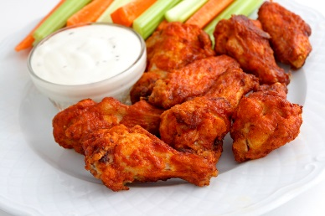
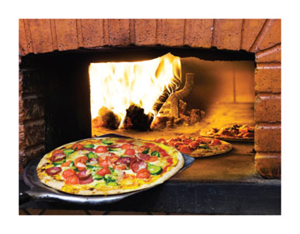
Specialization and Trade
Improvements in technology and more resources can make an economy more productive.
Specialization and trade can also create gains for society.
Assume now
Two goods (pizza and wings)
Two people with different abilities in the production of pizza and wings

Slide 19

Absolute Advantage
 | Daily Production
Person | Pizzas | Wings
Debra Winger | 60 | 120
Mike Piazza | 24 | 72
Absolute advantage
One person can perform each task more effectively than the other person.
Who has the absolute advantage in pizza? In wings?
Notes:
Here, Debra and Mike can each make pizza and wings.
It appears Debra is better than Mike at production of both goods. Can these two people still benefit from trade? Yes; gains from trade depend on comparative advantage, NOT absolute advantage.

Slide 20
Without Trade Situation
 |  | Without Trade
Person | Good | Production | Consumption
Debra | Pizza | 40 | 40
 | Wings | 40 | 40
Mike | Pizza | 18 | 18
 | Wings | 18 | 18
Without specialization and trade
Mike and Debra each have to produce their own wings and pizza.
Each person can only consume what they produce.
Notes:
Since Debra and Mike can produce at any point along their production possibilities frontiers, it is helpful to assume that they initially enjoy both foods equally so they try to produce the same amount of each. When this is the case, Debra produces 40 pizzas and 40 wings while Mike produces 18 pizzas and 18 wings. Since Debra is more productive in general, she produces more of each food. We say that Debra has an absolute advantage, meaning that she is as good, or better, than Mike at producing both items.
At first glance, it would appear that Debra should work alone.
In economics, we generally assume that consumers enjoy variety. This is why Debra and Mike are each producing some of each good.

Slide 21
Without Trade Situation
40
Notes:
Why a linear PPF for an individual?
For society, the PPF was curved due to heterogeneity of inputs. This means that different inputs (capital and labor and resources) all have different abilities in production. Here, we are just looking at a single person and his/her ability to produce pizza or wings.
Debra and Mike each face a constant trade-off between producing pizza and wings. For Debra, this means that her trade-off between producing pizza and wings is fixed at 1:2 (she produces 60 pizzas for every 120 wings). Mike's trade-off between producing pizzas and wings is fixed at 1:3 (he produces 24 pizzas for every 72 wings). Since Debra and Mike can produce at any point along their production possibilities frontiers, it is helpful to assume that they initially enjoy both foods equally so they try to produce the same amount of each. When this is the case, Debra produces 40 pizzas and 40 wings, while Mike produces 18 pizzas and 18 wings. Since Debra is more productive in general, she produces more of each food. We say that Debra has an absolute advantage, meaning that she is as good, or better, than Mike at producing both items.

Slide 22

Shaq and Comparative Advantage
SNAPSHOT
Shaq was a basketball star, but he also would have been a star mover. Experienced movers can earn $20 an hour. With Shaq's strength, he might have been worth $40 an hour. He had an absolute advantage in basketball AND moving.
But Shaq made an average of $15 million a year playing basketball! That's over $40,000 a day. Giving up basketball for moving would have meant a huge opportunity cost. When it comes to moving, the movers had a comparative advantage. It was a no-brainer for Shaq to hire them and devote his time to hoops!
Notes:
If you ever saw Shaquille O'Neal use his size and strength on the basketball court, you might wonder how someone could have any kind of advantage over him. But when it comes to comparative advantage, opportunity costs tell the tale. Let's take a look at the numbers.
REVIEW QUESTIONS
If you are better than your roommate at both cooking dinner and cleaning the apartment, does that mean you should be responsible for both tasks? Use comparative advantage to explain..
If you have a comparative advantage in doing something, do you experience a high or low opportunity cost?

Slide 23
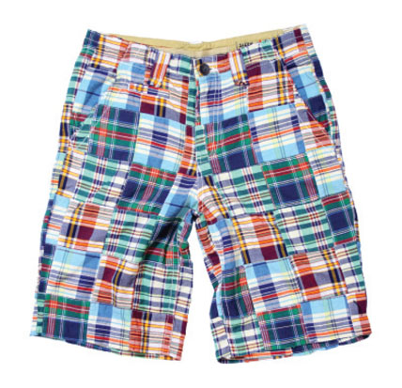
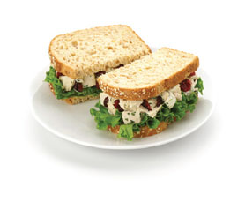
Comparative Advantage
Without trade, you would have to produce everything you consume.
You would have to make your own food, clothing, housing, and electronics.
You would have to do all your own services as well (hair-cutting, plumbing, dentistry, education)
Comparative advantage
The situation in which an individual, business, or country can produce at a lower opportunity cost than a competitor.
Allows gains from trade to occur.
Notes:
By fostering the exchange of goods, trade helps to create additional growth through specialization. Comparative advantage harnesses the power of specialization. As a result, it is possible to be a physician, teacher, or plumber and not worry about how to do everything yourself. The physician becomes proficient at dispensing medical advice, the teacher at helping students, and the plumber at fixing leaks. The physician and teacher call the plumber when they need work on their plumbing. The teacher and plumber see the doctor when they are sick. The physician and the plumber send their children to school to learn from the teacher. This trading of services increases the welfare of everyone in society. Trade creates gains for everyone involved.

Slide 24

Specialization and Trade
Specialization
You go to Starbucks to get coffee.
You go to the doctor when you're sick.
You don't have to do everything yourself: people specialize in what they're best at (lowest opportunity cost) and you can trade with them.
Trade controversies
India or China may have a comparative advantage (relative to USA) in labor-intensive goods.
Result: outsourcing of jobs
What if this causes an American worker to lose his job?
Notes:
Some countries have highly developed workforces capable of managing and solving complex processes. Other countries have large pools of relatively unskilled labor. As a result, businesses that need skilled labor gravitate to countries where they can easily find the workers they need. Likewise, firms with production processes that rely on unskilled labor, look for employees in less developed countries. By harnessing the power of increased specialization, global companies and economies are able to increase production and growth.

Slide 25
Opportunity Cost Calculation
 | Daily Production
Person | Pizzas | Wings
Debra Winger | 60 | 120
Mike Piazza | 24 | 72
 | Opportunity Cost
Person | 1 Pizza | 1 Wing
Debra Winger | 2 wings (120 ÷ 60) | 1/2 pizzas (60 ÷ 120)
Mike Piazza | 3 wings (72 ÷ 24) | 1/3 pizzas (24 ÷ 72)
Notes:
Opportunity cost is what could have been produced instead. When Debra makes pizzas, she COULD HAVE made wings instead. We can use division to find the numerical quantities.
In this bottom table, it is important to note that we are looking for a number AND a unit.
When Debra makes a pizza, she gives up wings. Specifically, she gives up 2 wings for each pizza she makes. When she makes a wing, she gives up half a pizza. Note that these numbers (2 and ½) are reciprocals of each other.
The same analysis can be done for Mike.

Slide 26
Opportunity Cost
 | Opportunity Cost
Person | 1 Pizza | 1 Wing
Debra Winger | 2 wings (120 ÷ 60) | 1/2 pizzas (60 ÷ 120)
Mike Piazza | 3 wings (72 ÷ 24) | 1/3 pizzas (24 ÷ 72)
Comparative advantage
Debra: comparative advantage in pizza production
She gives up fewer wings than Mike.
Mike: comparative advantage in wing production
He gives up fewer pizzas than Debra.
Notes:
Note that with a simple two-person two-good model, one person will always have the comparative advantage in one good, and the other person will have the comparative advantage in the other good.
This is true even if one person has the absolute advantage in both goods. Gains from trade can occur even if one person is absolutely better in production of both goods.

Slide 27
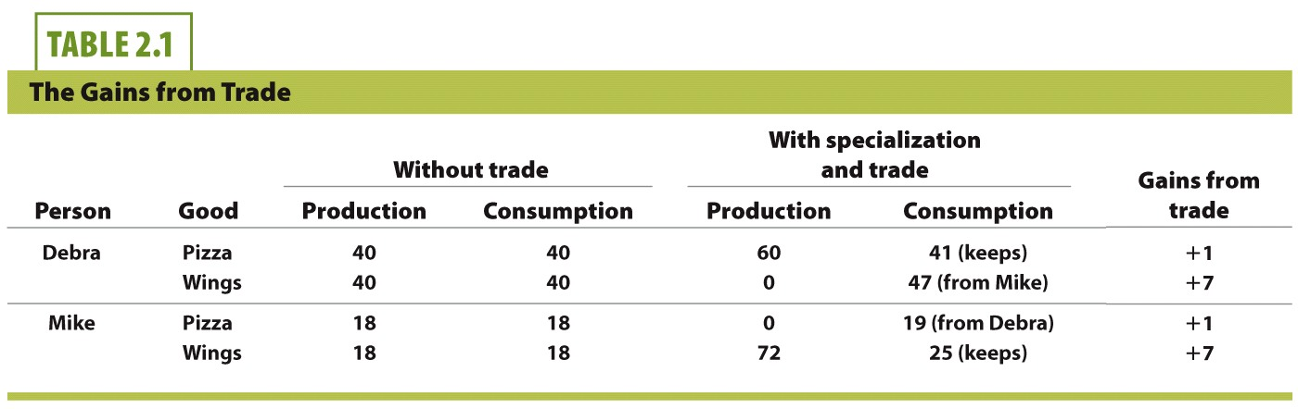
With Specialization and Trade
 |  | With Trade |  | Gains from Trade
Person | Good | Production | Consumption
Debra | Pizza | 60 | 41 (keeps) | + 1
 | Wings | 0 | 47 (from Mike) | + 7
Mike | Pizza | 0 | 19 (from Debra) | + 1
 | Wings | 72 | 25 (keeps) | + 7
With specialization and trade
Debra produces pizza and gives 19 pizzas to Mike;
Mike produces wings and gives 47 wings to Debra;
Each person consumes more with trade.
Notes:
When Debra specializes and produces only pizza, her production is 60 units. In this case, her individual pizza output is greater than the combined production of 58 pizzas (Debra's 40 + Mike's 18). Similarly, if Mike specializes in wings, he is able to make 72 units. His individual wing output is greater than their combined output of 58 wings (Debra's 40 + Mike's 18). Specialization has resulted in the creation of two additional pizzas and 14 additional wings.
But Debra and Mike would like to have both pizzas and wings. So if they specialize and then trade with each other, they will each benefit. If Debra gives Mike 19 pizzas in exchange for 47 wings, they are each better off by one pizza and 7 wings.

Slide 28
Gains from Trade
Notes:
On each graph for each person, it is possible to produce (and consume) without trade at points A and B. By themselves with no trade, point B might be better than A since consumers generally prefer variety in consumption. However, with specialization and trade, any person can consume at point C on their graph. Point C is clearly better than point B, since point C has more of BOTH goods for each person. This graph shows the gains from trade.
With trade, we are able to consume beyond what we would have been able to produce by ourselves.
The numbers at point C come from the table in the previous slide.

Slide 29
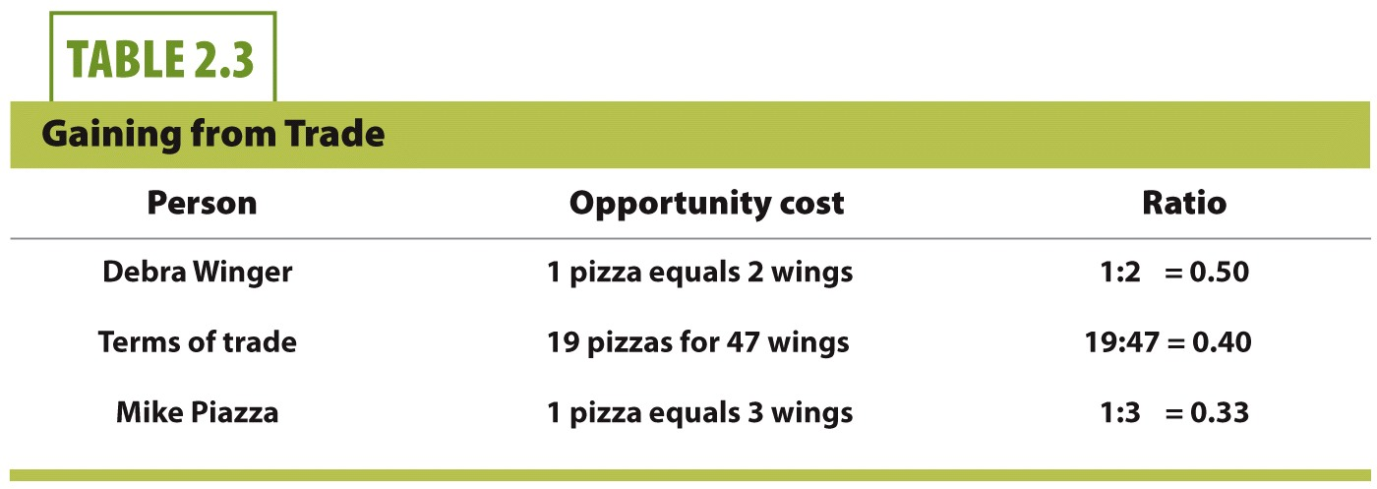
Terms of Trade
Person | Opportunity Cost | Ratio
Debra Winger | 1 pizza equals 2 wings | 1:2 = 0.50
Terms of trade | 19 pizzas for 47 wings | 19:47 = 0.40
Mike Piazza | 1 pizza equals 3 wings | 1:3 = 0.33
Terms of Trade
As long as the terms of trade are between the opportunity costs of the trading partners, the trade benefits both sides.
Notes:
The terms of trade need to be made such that trade benefits both parties. Thus, with production from Mike and Debra, we need to find out how many wings each pizza is worth for both people.
The terms of trade need to be set somewhere between these two boundaries.
Detail from text:
If Mike insists on a trading ratio of one wing for one pizza, which would be a good deal for him, Debra will refuse to trade because she will be better off producing both goods on her own. Likewise, if Debra insisted on receiving 4 wings for every pizza she gives to Mike, he would refuse to trade with her because he would be better off producing both goods on his own.

Slide 30
Gains from Trade
Previously, we noted the gains from trade and specialization.
Terms of trade
The relative prices, or exchange rate of goods.
How many wings per pizza?
Notes:
For terms of trade, we further need to ask the following: how are the terms of trade determined so trade can benefit both people?

Slide 31
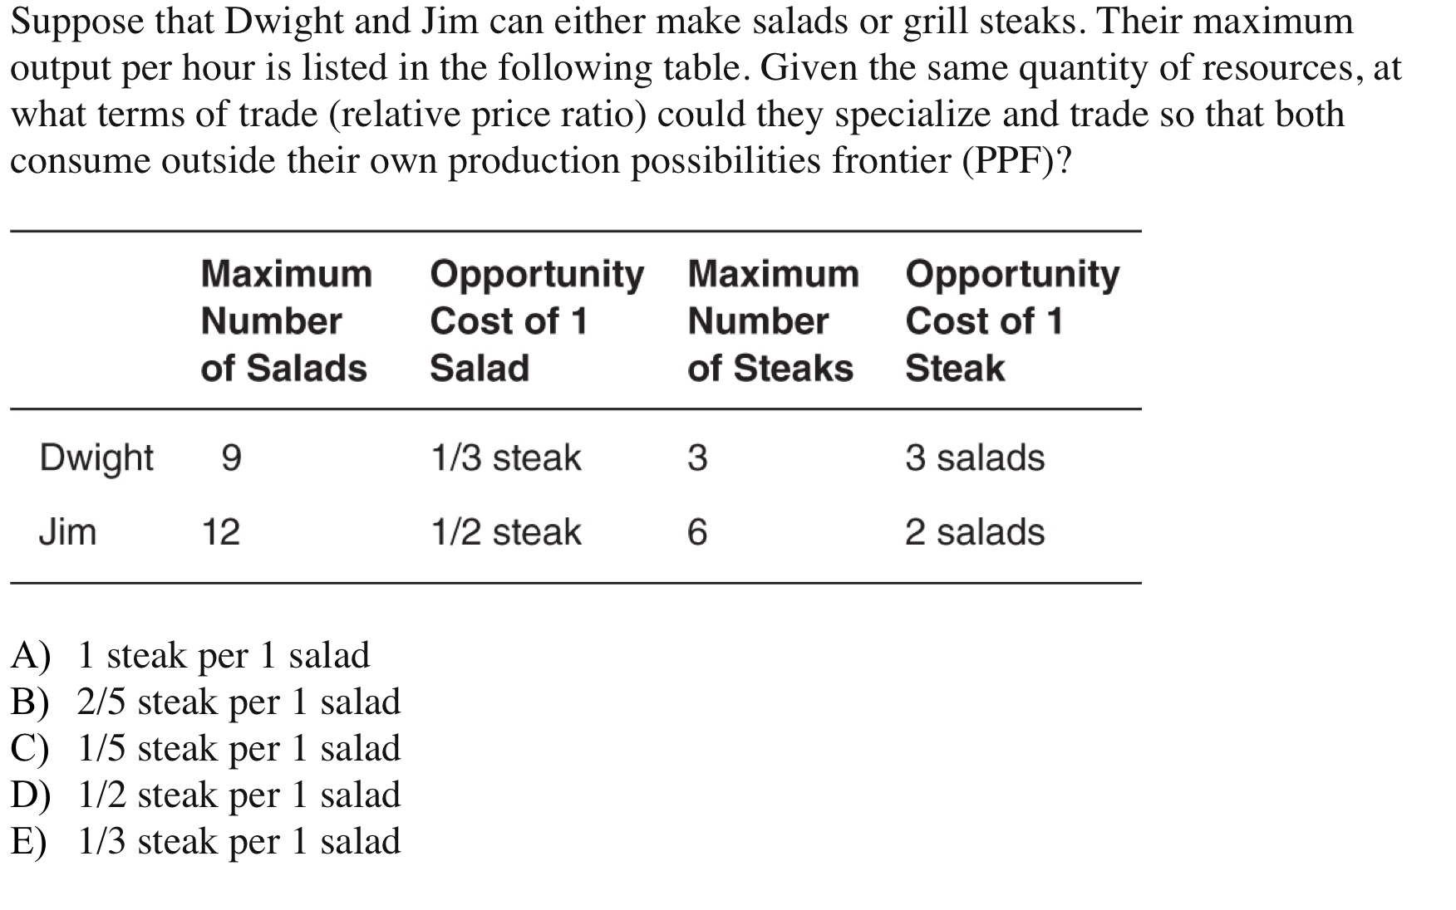
Notes:
Answer: B

Slide 32
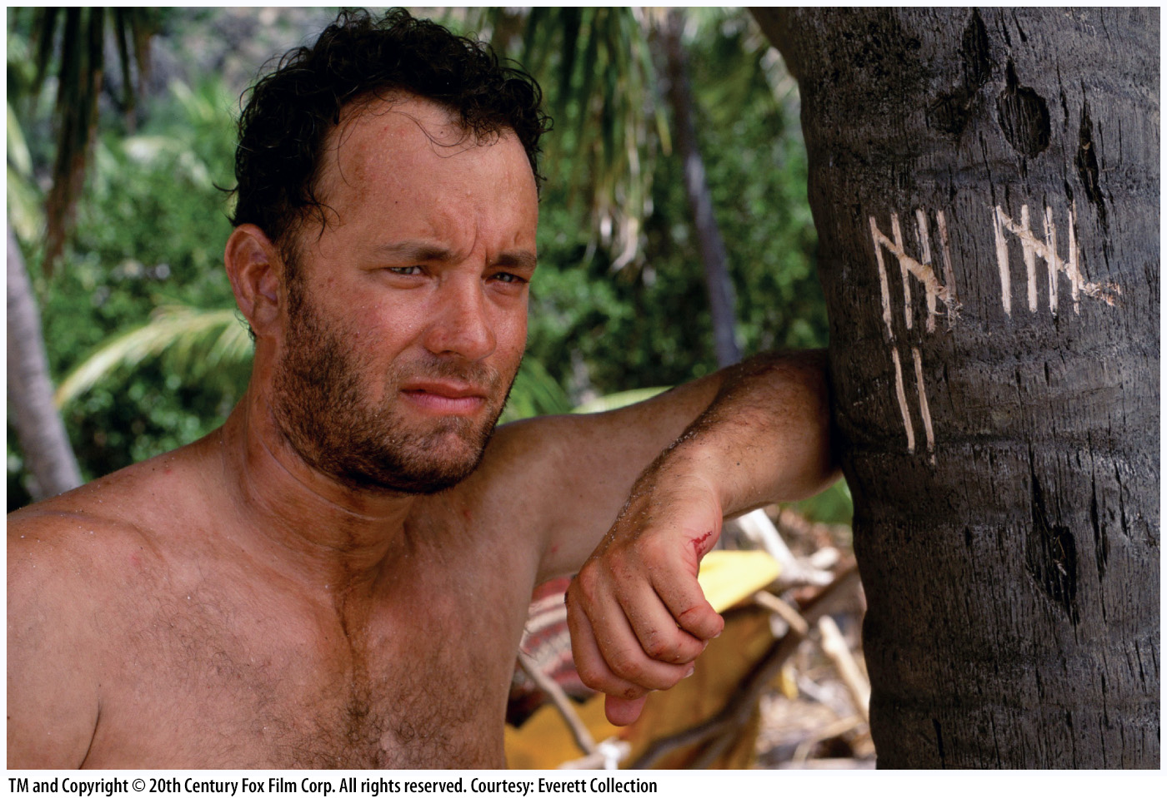
Economics in Cast Away
"Cast Away (2000)"
Imagine a world in which there was no specialization and trade.
You would have to do everything by yourself.
Your consumption = your production

Slide 33
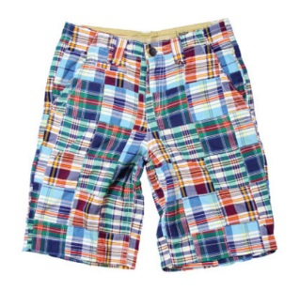
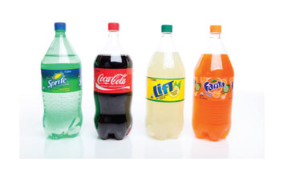
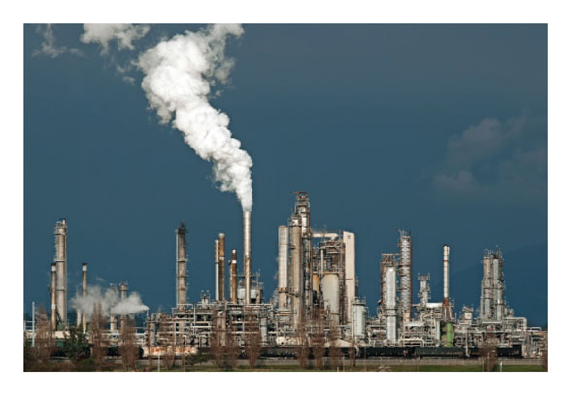
Trade-off Between Present and Future
Consumer goods
Goods produced for current consumption
Food, housing, clothing, entertainment
Capital goods
Goods that help produce other valuable goods
Buildings, factories, roads, machinery, computers
Investment
Using resources to make new capital

Slide 34
Capital Goods and Future Growth
Notes:
When a society chooses point A in the short-run, very little capital goods are created. Since capital goods are needed to enhance future growth, the long-run PPF expands, but only slightly.

Slide 35
Capital Goods and Future Growth
Notes:
When a society chooses point B in the short-run, many capital goods are created. Since capital goods are needed to enhance future growth, the long-run PPF expands significantly.
Thus, we see the trade-offs: we want to plan for our future to increase our standard of living, but we often do not want to give up today's consumption. In addition, we still must produce at least some consumption goods during each time period. (We'll always need food, housing, and clothing).

Slide 36
Capital Goods and Future Growth
Over the last 20 years, China and India have invested in more capital compared to the United States and Europe.
The result?
China is sacrificing today's consumption for a better future.
China and India have higher growth rates.
Another trade-off: Chinese workers have less leisure time than American workers.
Notes:
Beyond the scope of this course: Higher growth rates in India and China also are explained by the Solow growth model. The farther away from the steady state an economy is, the faster it moves toward that steady state. The model shows that less developed economies grow at a faster rate than developed economies.

Slide 37
Practice What You Know
With regard to the PPF, an efficient point is a point that is
impossible to reach.
inside the PPF.
outside the PPF.
on the PPF.
Notes:
Correct answer: D
Efficient points are ON the PPF.
Inefficient points are INSIDE the PPF.
Points outside of the PPF are currently unattainable.

Slide 38
Practice What You Know
If we move down and to the right along a PPF, the opportunity cost of this movement can be measured in terms of
how much of the x-axis good we gain.
how much of the y-axis good we gain.
how much of the x-axis good we give up.
How much of the y-axis good we give up.
Notes:
Correct answer: D
Why is C not correct? The PPF is downward-sloping.
If we move down and to the right, we gain some x-axis goods, but at a cost of losing some y-axis goods.
Why is A not correct? Because opportunity cost is what we give up, not what we gain.

Slide 39
Sources
"Principles of Economics with Smartwork Access (ISBN: 978-0-26314-5), 1st Edition, 2013" by Mateer and Coppock
"Economics: Custom Edition for NCSU (ISBN: 9781937435202 " by David Hyman

